Slide 1

Social
Media
Aesthetic
Intention
Lyrics
Lead Sheets
Markov
Generation
with
Constraints
Filter & Self-
Evaluation
Output
Information Flow
Decision Influence
Filter Gate

Slide 2
Tweets
Interests
Intention
Lyrics
Sheet
Music
Generation
Patterns
Evaluation
♬
♫
Output
♩

Slide 5
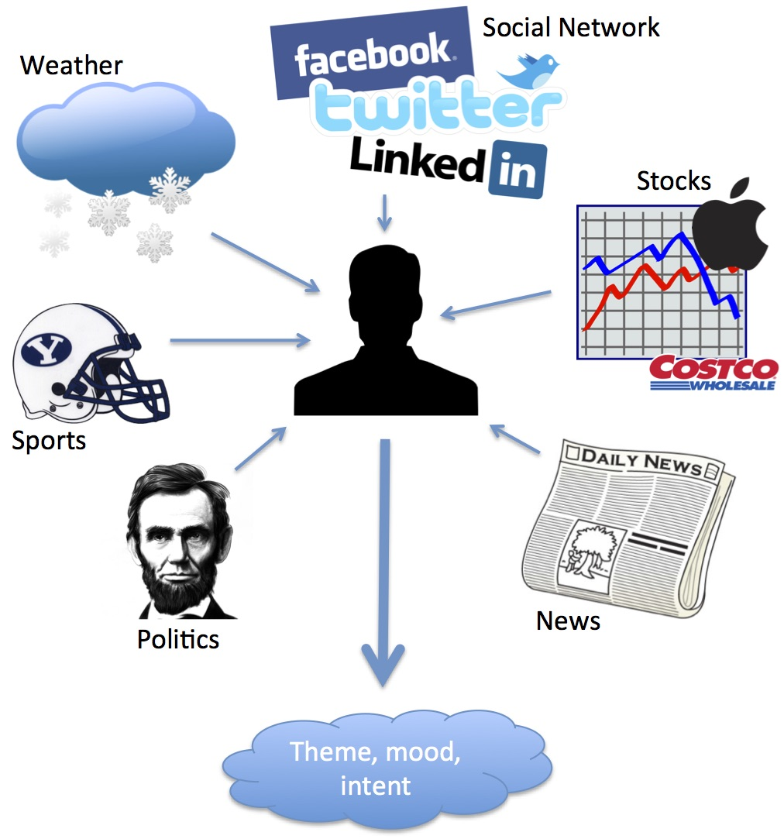

Slide 6
Aesthetic
Intention
Structure
Harmony
Pitch
Rhythm
Lyrics

